Slide 1
More Fun with functions
Cindy stenger

Slide 2
You have come a long way
We started this CS Makers Journey last summer, with programming basics, what is a variable, if statements, if then else statements, loops, functions . . .
In the last session, we put many of these together in the traffic light activity, that highlighted functions.

Slide 3
functions:
One of the coolest structures
in the computer science world is the function.
Functions (sometimes called procedures)
are mini programs that you can use
over and over inside of your bigger program.
This lesson will help you intuitively
understand why combining chunks of code
into functions can be such a helpful practice.

Slide 4

It might seem crazy what I'm about to say Sunshine she's here, you can take a break I'm a hot air balloon that can go to space With the air, like I don't care baby by the way (come on)
Because I'm happy Clap along if you feel like a room without a roof Because I'm happy Clap along if you feel like happiness is the truth Because I'm happy Clap along if you know what happiness is to you Because I'm happy Clap along if you feel like that's what you wanna do (hey)
Here come bad news talking this and that (yeah) Well, give me all you got, and don't hold it back (yeah) Well, I should probably warn you, you'll be just fine (yeah) No offense to you, don't waste your time (Here's why)
Because I'm happy Clap along if you feel like a room without a roof Because I'm happy Clap along if you feel like happiness is the truth Because I'm happy Clap along if you know what happiness is to you Because I'm happy Clap along if you feel like that's what you wanna do
Here go (Happy) Bring me down Can't nothing (happy) Bring me down My level's too high (happy) To bring me down
To bring me (Let me tell you now) Bring me down Can't nothing Bring me down His level's too high To bring me down To bring me down
Because I'm happy Clap along if you feel like a room without a roof Because I'm happy Clap along if you feel like happiness is the truth Because I'm happy Clap along if you know what happiness is to you Because I'm happy Clap along if you feel like that's what you wanna do
Because I'm happy Clap along if you feel like a room without a roof Because I'm happy Clap along if you feel like happiness is the truth Because I'm happy Clap along if you know what happiness is to you Because I'm happy Clap along if you feel like that's what you wanna do

Slide 5
It might seem crazy what I'm about to say Sunshine she's here, you can take a break I'm a hot air balloon that can go to space With the air, like I don't care baby by the way
CHORUS
Here come bad news talking this and that Well, give me all you got, and don't hold it back Well, I should probably warn you, you'll be just fine No offense to you, don't waste your time
CHORUS
Bring me down Can't nothing Bring me down My level's too high To bring me down
Bring me down Can't nothing Bring me down His level's too high To bring me down To bring me down
CHORUS
CHORUS
Chorus:
Because I'm happy Clap along if you feel like a room without a roof Because I'm happy Clap along if you feel like happiness is the truth Because I'm happy Clap along if you know what happiness is to you Because I'm happy Clap along if you feel like that's what you wanna do

Slide 6
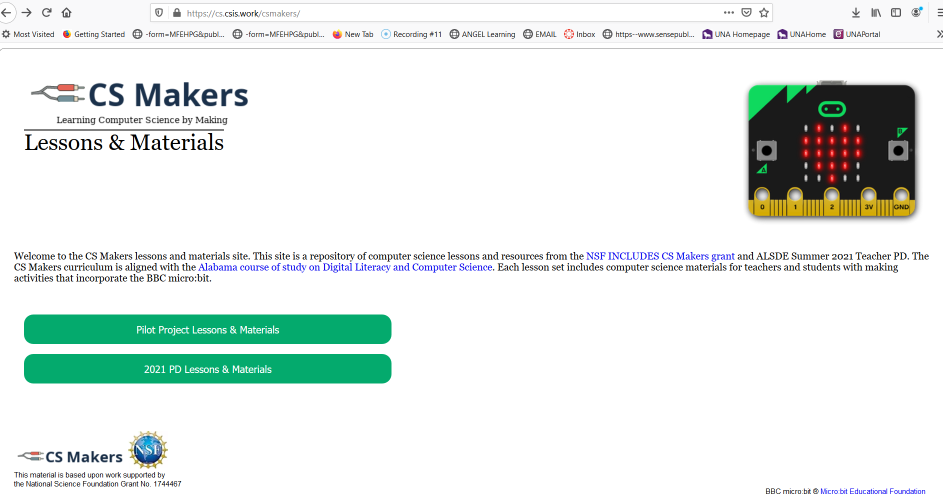
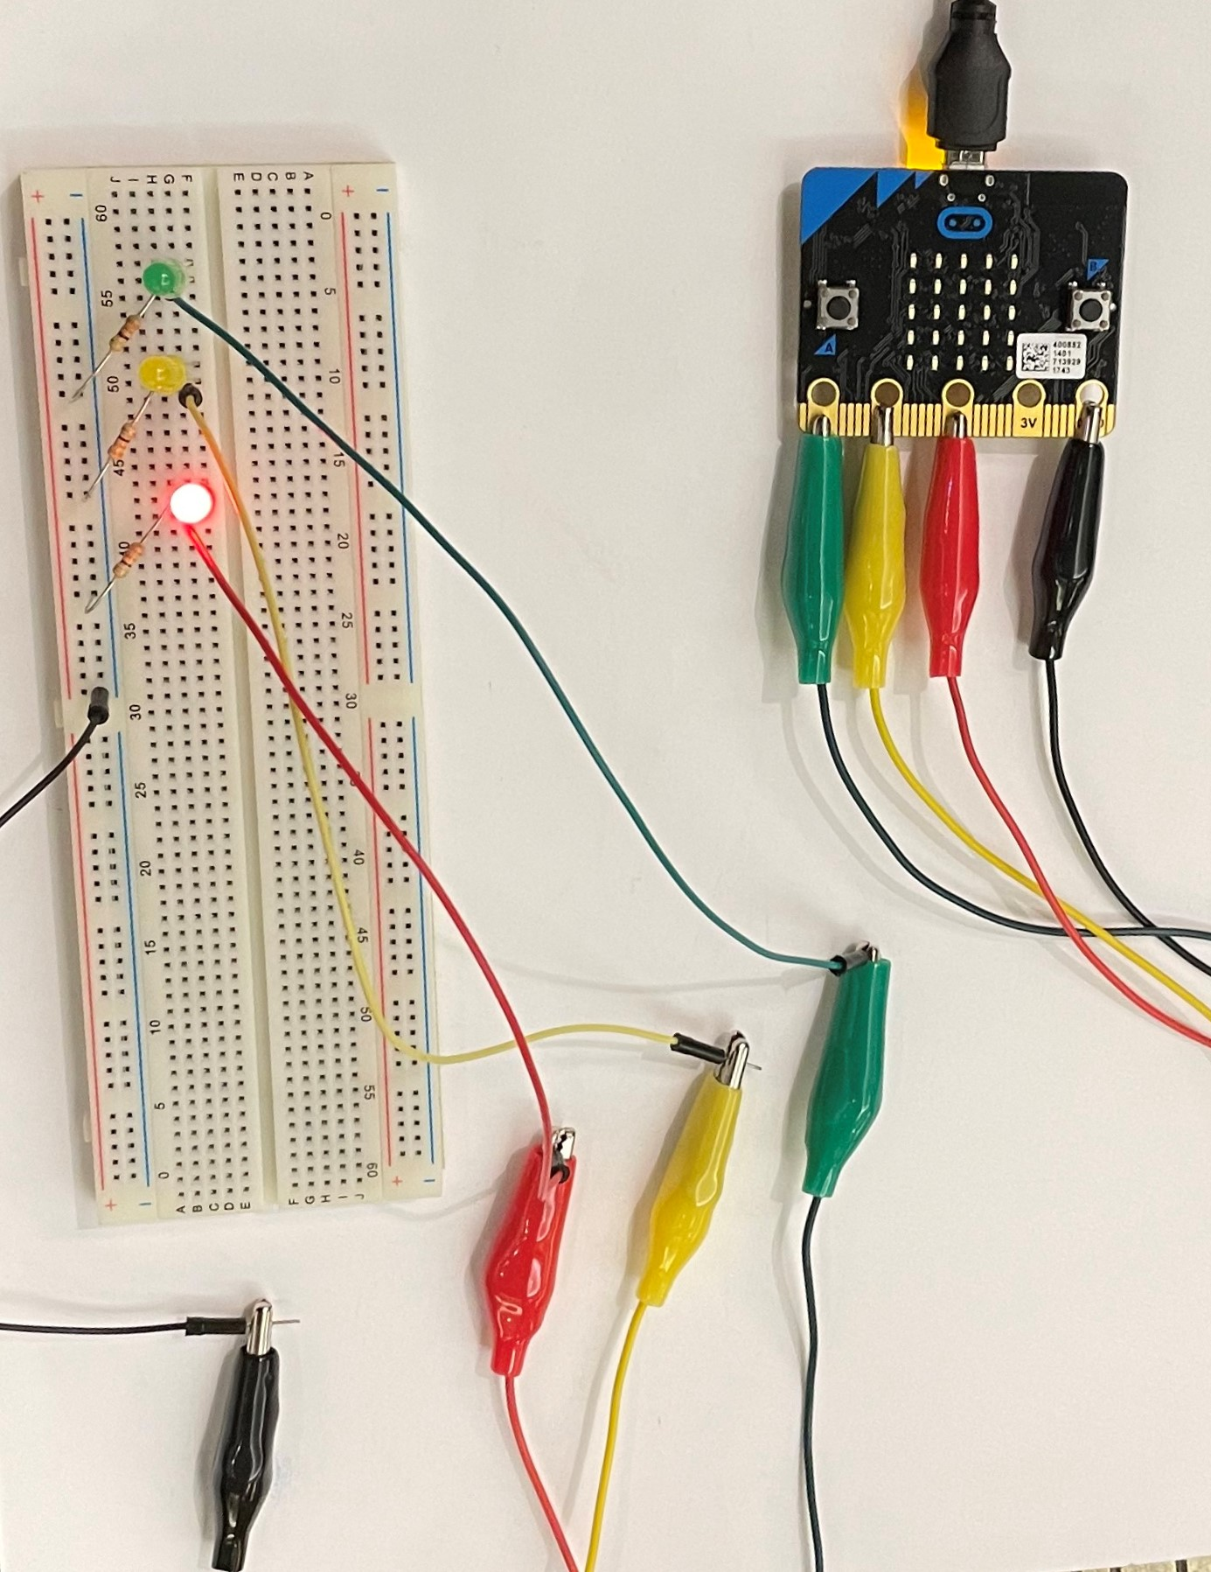
Traffic Light program is newly available on Your CS Makers web site http://cs.csis.work/csmakers/

Slide 7
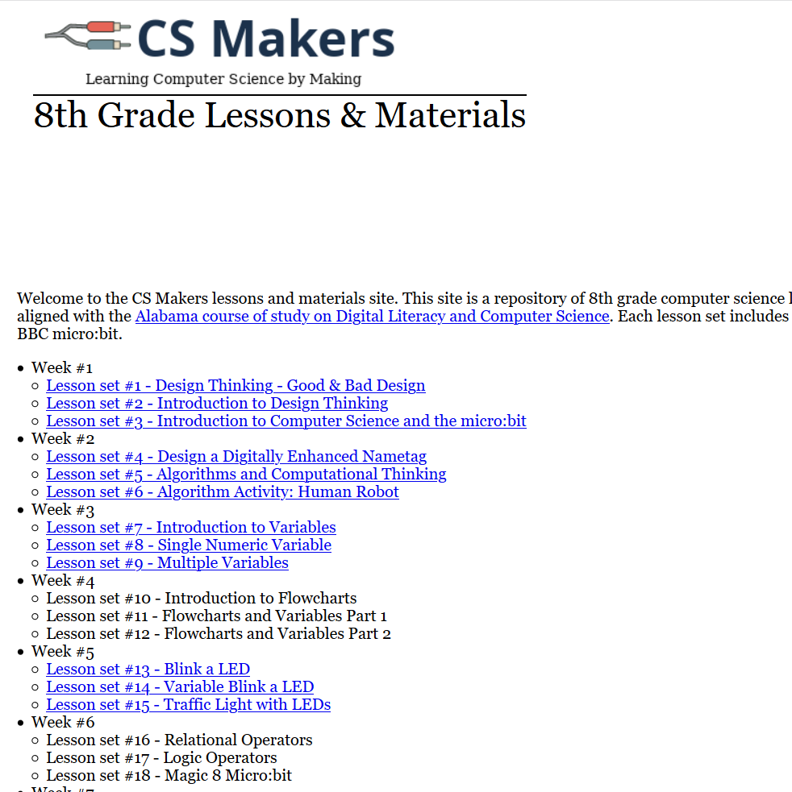
LESSON #15

Slide 8
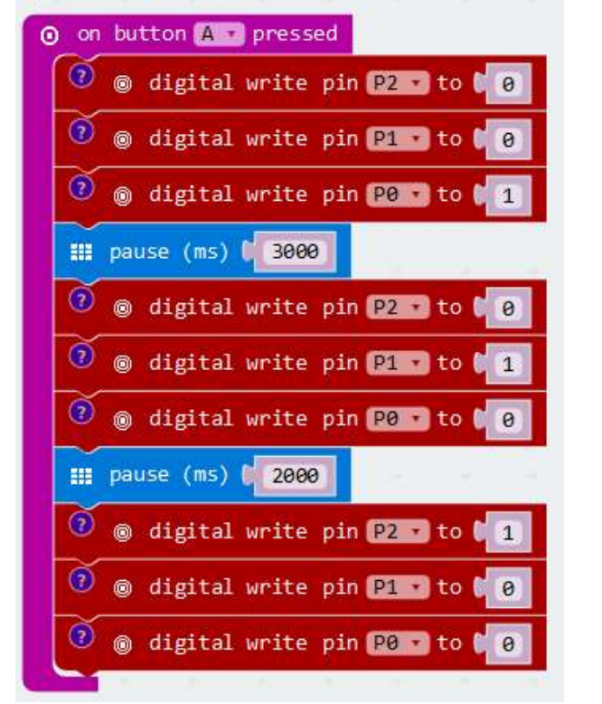
Traffic light program

Slide 9


Can we use functions to simplify this program?
Our traffic light is initialized as red and we are “waiting for a car to arrive.” We will use a pushbutton to indicate a car has been detected.
Once a car arrives, we will change the light to green and start a timer to change from green to yellow to red again.
Let’s use a FUNCTION to operate the lights.

Slide 10
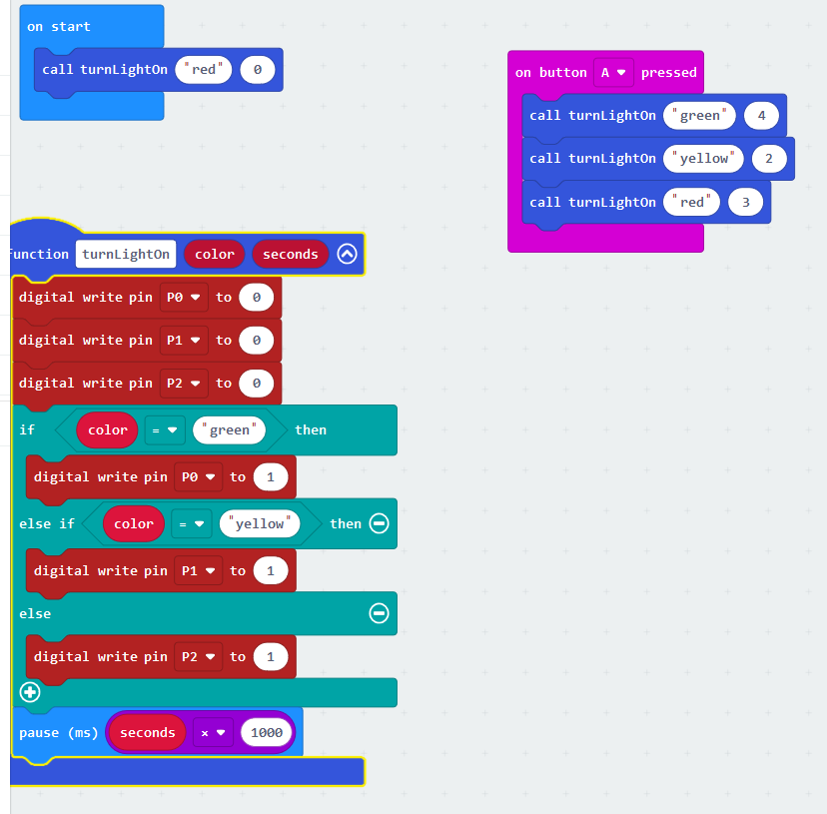
Traffic light using function

Slide 11
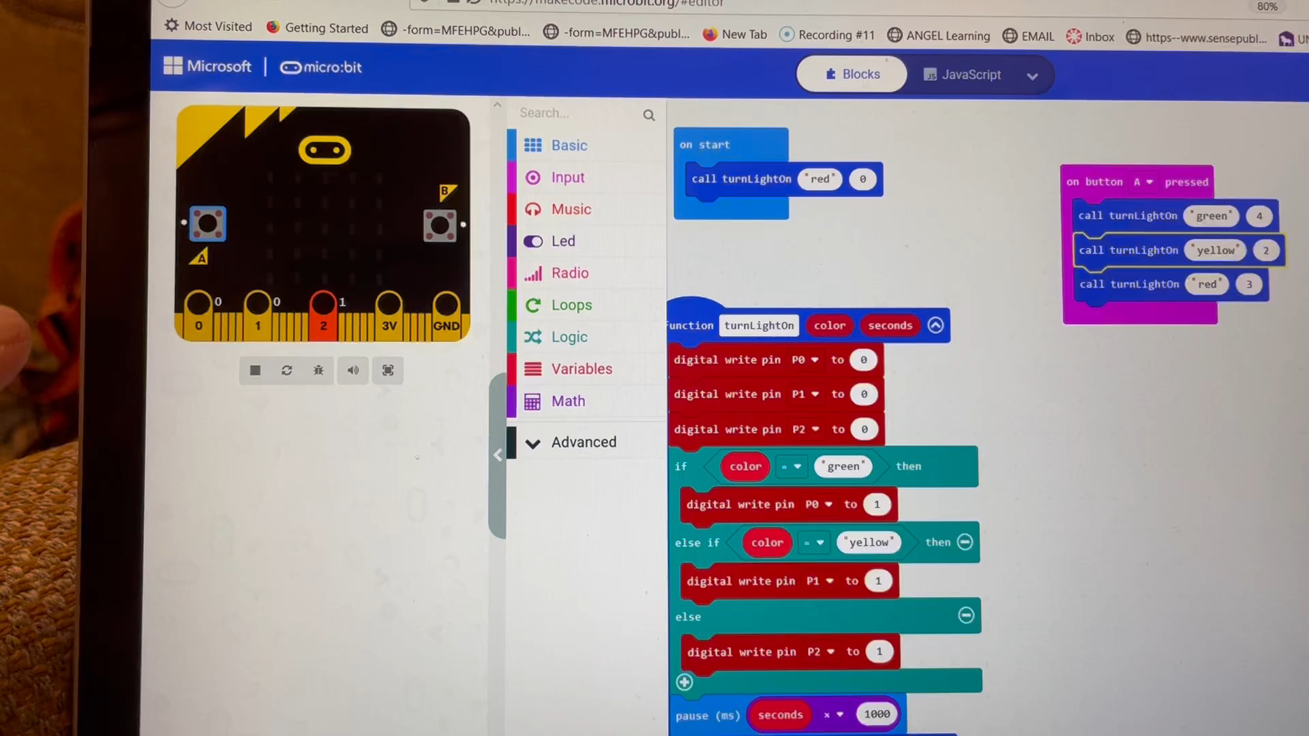
Check your program on the emulator

Slide 12
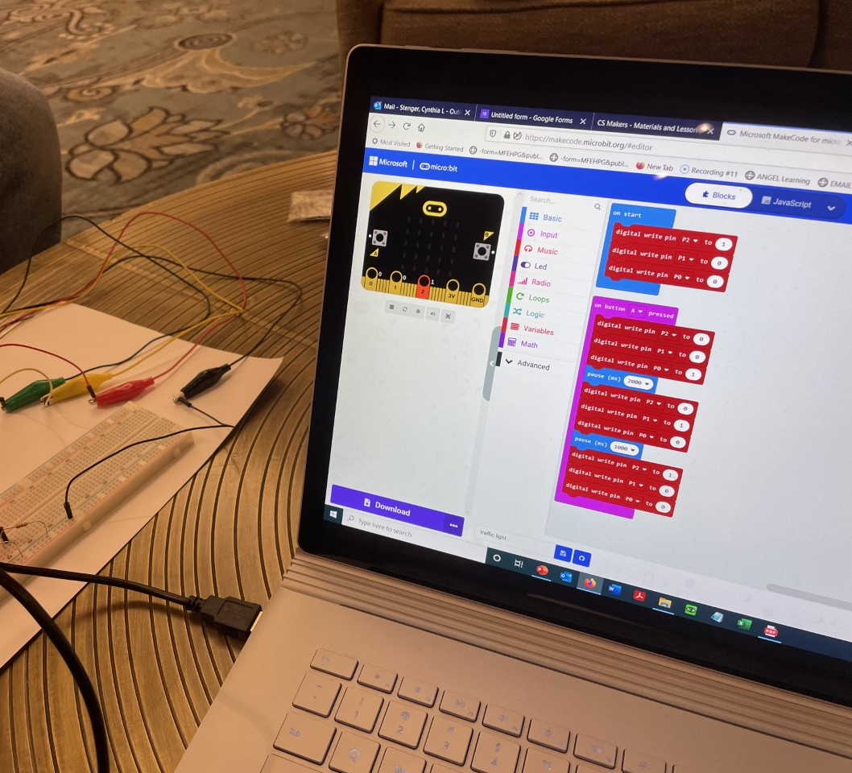
Download your program

Slide 13
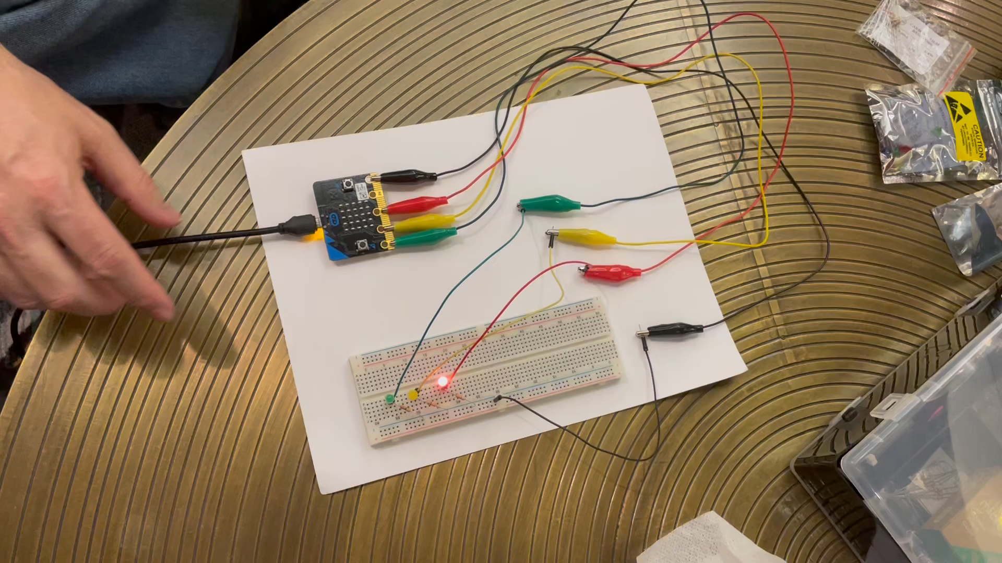
Video of traffic light

Slide 14
Build a countdown tool
We already built a countdown from 10 and we made some modifications
But this morning we want to build a tool that will countdown from a random number. Then we will get fancy and ask it to count “up” from a random number.
So let’s open up Microsoft MakeCode…

Slide 15
Overview
1. On shake - Pick a random number between 1 and 10
2. Press Button A - Call a function to Countdown (Descending)
3. Press Button B - Call a function to Count-up (Ascending)

Slide 16
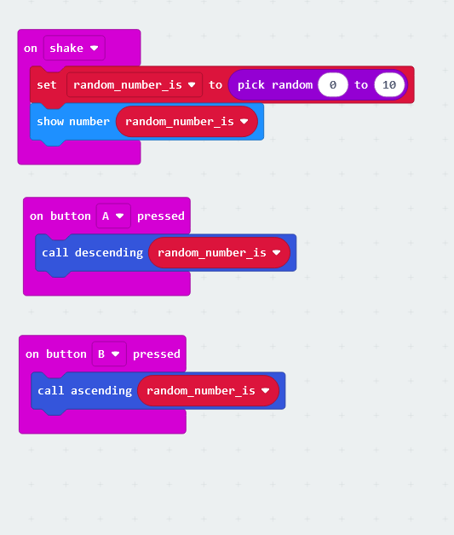
The 3 main parts look like this
Shake
Get a random number and show it
Button A
descending
Button B
ascending

Slide 17
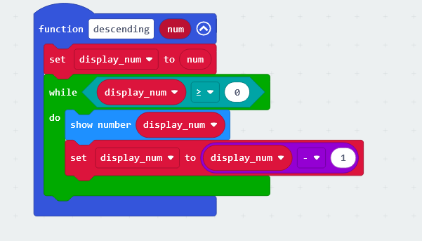
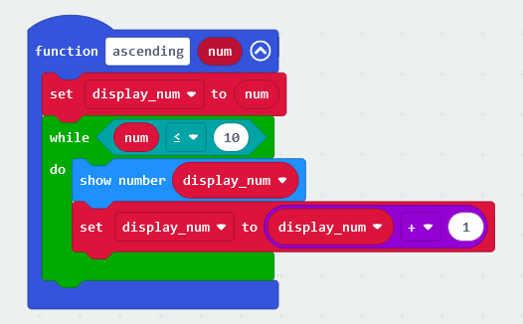
Write the functions
Function to countdown - descending
Function to count-up - ascending

Slide 18
